Slide 1
Handwritten Digit Recognizer
Project Presentation
Jagadev Veeranki

Slide 2
Aim
The aim of this project to build different deep learning models to detect handwritten digits and deploy them on a mobile application and compare their accuracy, precision and the loss function.

Slide 3
About the project
Handwritten digit recognition is a multiclass classification problem. In this project, I am implementing the following architectures/Neural Network:
MobileNet
Visual Geometry Group(VGG)
Binary Neural network

Slide 4
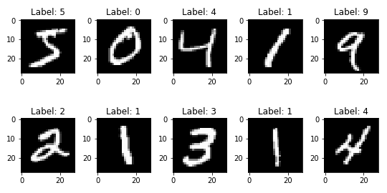
MNIST Dataset
The MNIST database (Modified National Institute of Standards and Technology database) is a large database of handwritten digits that is commonly used for training various image processing systems.
Notes:
The MNIST dataset consists of 28x28 pixel grayscale images of handwritten digits (0 through 9) along with their labels.
Train : 60000 images Testing : 10000 images

Slide 5
MobileNet
MobileNet is a group of network architectures that are developed to facilitate running machine learning on resource constrained devices.

Slide 6
Model Overview and Architecture
Data Processing: Images are
normalized to a [0, 1] scale.
resized to 32x32 pixels to fit the MobileNet input requirements.
Labels converted to one-hot encoding for 10 classes (digits 0-9).
Model Architecture:
Base model: MobileNet adapted for 32x32 grayscale images, trained from scratch (no pre-trained weights).
Added layers:
Global Average Pooling 2D.
Dropout (50%) to prevent overfitting.
Two Dense layers:
One Layer with 128 units (ReLU activation)
A final output layer with 10 units (Softmax activation).
Notes:
To improve model convergence and to maintain consistency images are normalized to [0,1] scale.
Global Average Pooling : to reduce spatial dimensions

Slide 7
Training and Performance
Training Setup:
Optimizer: Adam
Loss function: Categorical Crossentropy
Metrics: Accuracy, Precision
Trained over 5 epochs with a batch size of 32.
Performance:
Final test accuracy: approximately 98.56%.
Training and validation loss decreased consistently, indicating effective learning and generalization.

Slide 8
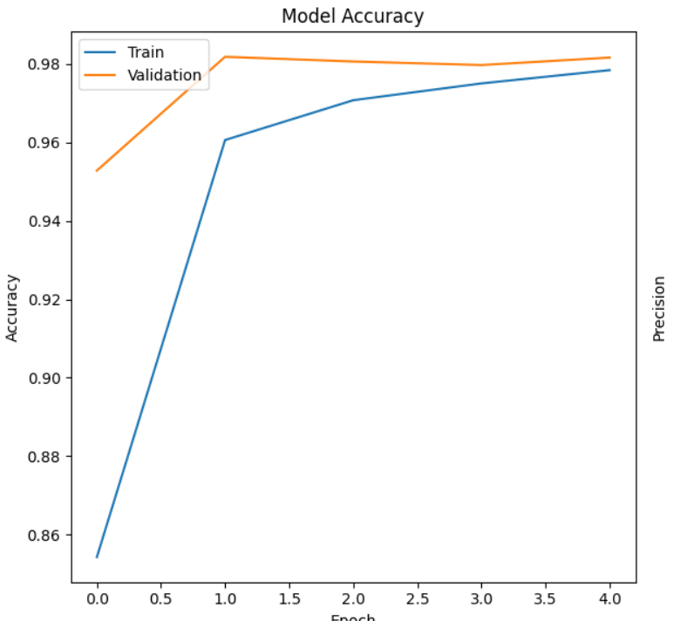
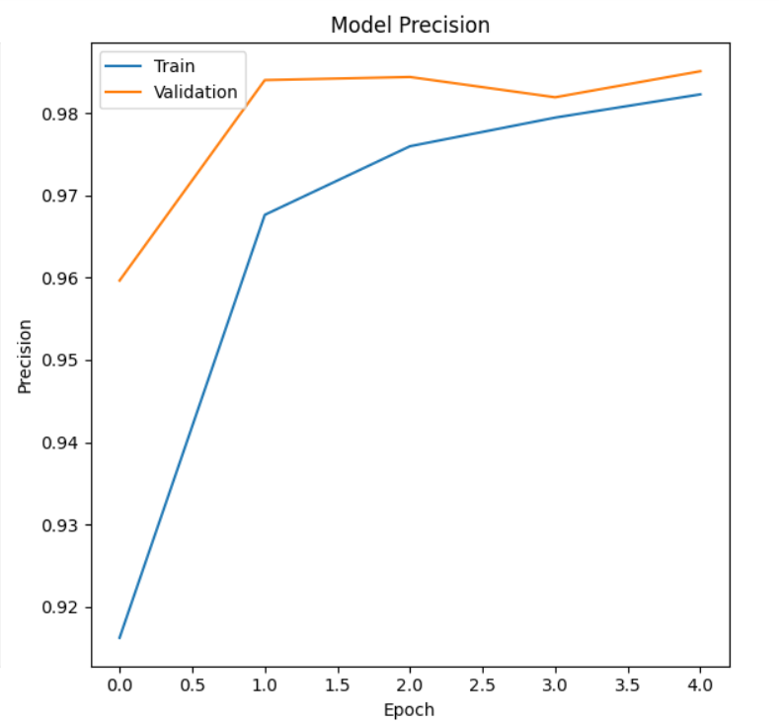
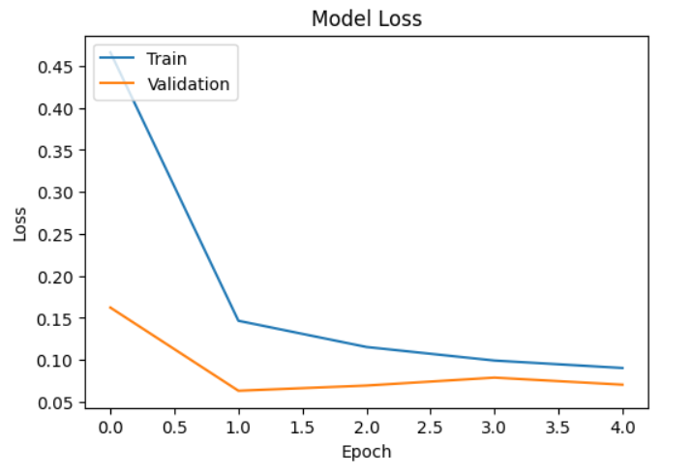
Training Data
Accuracy
Precision
Loss
Accuracy, Precision and Loss across Epochs

Slide 9
VGG
Visual Geometry Group is a convolutional Neural Network.
VGG is characterized by its simplicity, using mostly 3×3 convolutional layers stacked on top of each other in increasing depth.
The model I implemented has total of 13 Layers.
Notes:
A Convolutional Neural Network (CNN) architecture is a deep learning model designed for processing structured grid-like data, such as images. It consists of multiple layers, including convolutional, pooling, and fully connected layers.
Convolution Layers: 9
Flatten Layers : 1
Fully Connected layers : 3

Slide 10
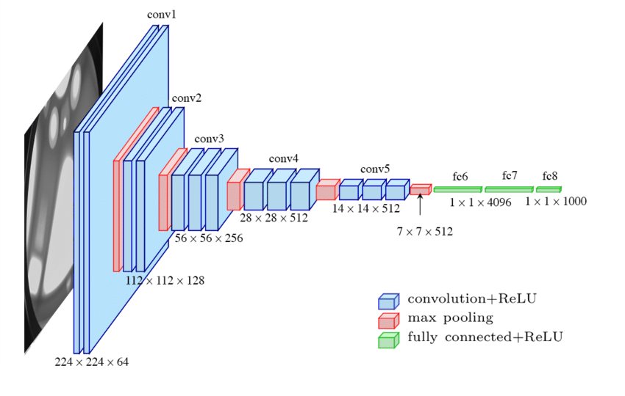
VGG Architecture
Notes:
The Image is VGG 16 architecture

Slide 11
VGG
Input : 28 x 28 x 1
Optimiser : adam
Loss Function : categorical_crossentropy
Batch Size : 128
Epochs : 10
Validation Split: 0.1
Training Accuracy: 98
Testing Accuracy: 99
Loss : 04.56
Notes:
A validation dataset is a sample of data held back from training your model that is used to give an estimate of model skill while tuning model’s hyperparameters.

Slide 12
Observations and Improvements
The training time for each epoch is around 25 minutes. I would like to :
Reduce the training time
Implement early stopping to optimize training time and possible overfitting.

Slide 13
Binary Neural Network
BNN is a type of neural network that activations(or called features) and weights are 1-bit values in all the hidden layers (except the input and output layers).

Slide 14
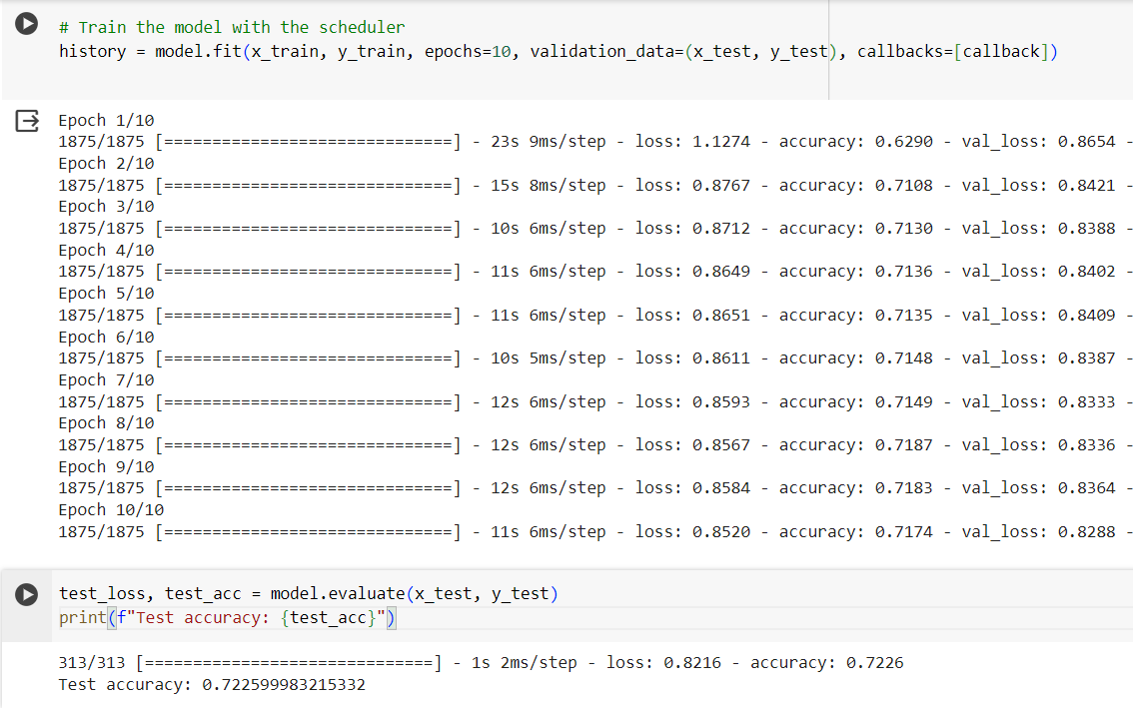
Implementation

Slide 15
Challenges
Underfitting :
Initially, the model did not capture the complexity of the MNIST dataset adequately, indicating underfitting.
Performance Plateaus:
The model frequently encountered plateaus where no significant learning improvements were seen.
Learning Rate Issue :
Learning rates must be tuned.

Slide 16
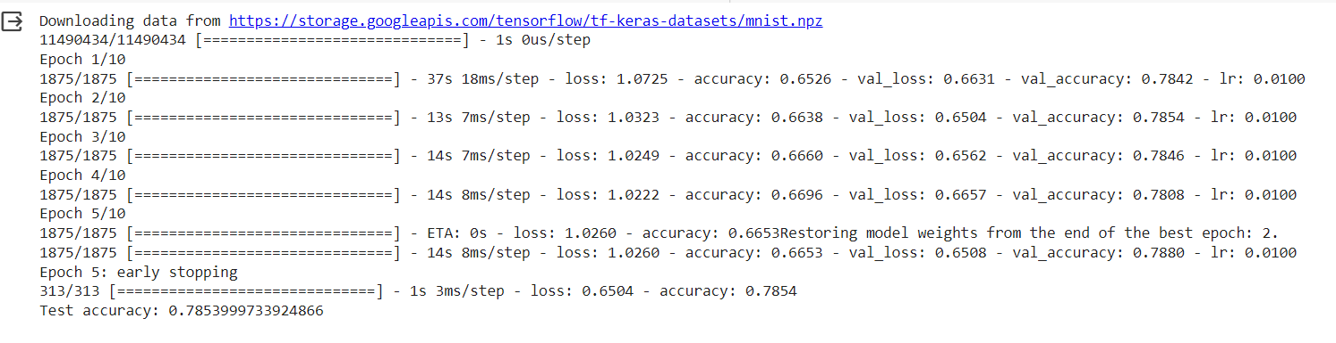
Increasing Model Complexity and implementing Early Stopping
Notes:
To combat underfitting I increased the number of neurons.

Slide 17
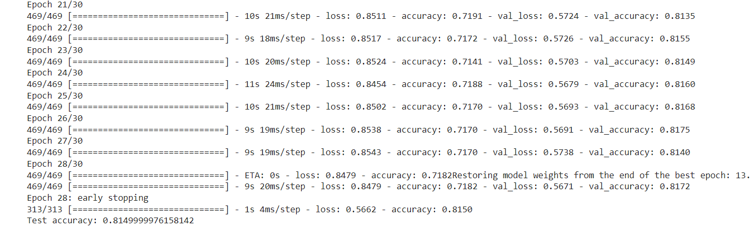
Lowering Learning Rate with Adam

Slide 18
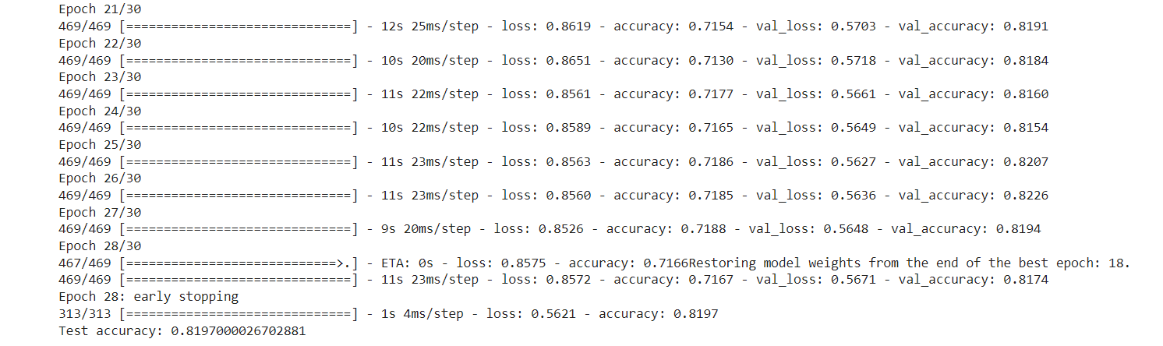
Implementing Cyclic Learning Rate
Notes:
CLR gives an approach for setting the global learning rates for training neural networks that eliminate the need to perform tons of experiments to find the best values with no additional computation.

Slide 19
Going Further
Deploying models on the mobile app
Optimizing the model to the app
Drawing Comparison and Analyzing Models
Final Report.

Slide 20

Thank You
Jagadev Veeranki
G01461368

